Slide 2
Chapter 6
Virtualization Technology (At Server)

Slide 3
Learning Outcomes
At the end of the session you will be able to:
Comprehend virtualization
Explain need of compute virtualization
Understand virtual clusters
Apply various techniques used for computing virtualization
Describe various resource management tools
Describe application of virtual machine
Describe hypervisor taxonomy
Appreciate the concept of virtual machine
Explain data center virtualization

Slide 4
Introduction
Virtualization refers to a technology that is used to make physical
resources available as virtual resources.
Cloud computing technologies use a set of techniques to create virtual
servers, virtual storage, virtual networks, and perhaps virtual applications as
well.
Virtualization software is used to make a physical server like a virtual server.
Operating system-level virtualization can be achieved by installing
virtualization software on already installed operating systems.

Slide 5
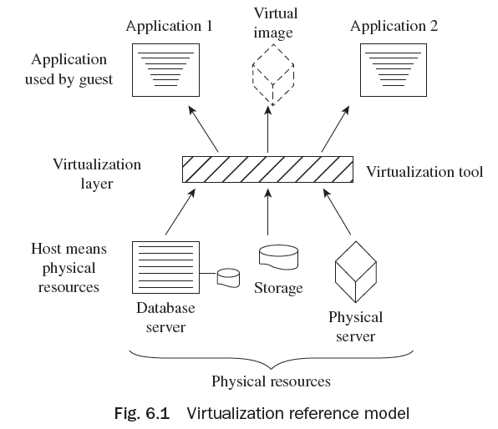
Virtualization Reference Model
The virtualization model consists of a host or physical resources in the first
layer, virtualization tool in the second layer,
and a guest in the third layer
(application as well as virtual image)
as shown in Fig. 6.1.

Slide 6
Advantages of Virtualization
The advantages of virtualization include the following:
It allows any network-enabled device to access any network application over any network.
It maintains isolation of one workload from another application to enhance security in the environment.
Virtualization of an application allows users to be comfortable with different versions of the operating system.
It can support and allow application with multiple instances to run on various machines concurrently.
It optimizes the use of a single system.
It enhances the reliability or availability of an application through redundancy.

Slide 7
Server/Compute Virtualization
Server/Compute virtualization in cloud computing refers to making a virtual edition of a device or resource, such as a server, storage device, network, or an operating system where the structure splits the resources as one or more environments for execution.
The following are the advantages of server/compute virtualization:
1. Consistency
2. Energy efficiency
3. Enhanced disaster recovery
4. Cost savings
A virtual machine is a reasonable computing system like a physical machine which governs an application and operating system (OS). Some of the virtual components used in a virtual machine are as follows:

Slide 8
Server/Compute Virtualization
A virtual machine (VM) can be configured with the following virtual components:
Virtual central processing unit (vCPU)
Virtual random access memory (vRAM)
Virtual disk
Virtual network adaptor (vNIC)
Virtual DVD/CD-ROM and floppy drives
Virtual SCSI (Small Computer System Interface) controller
Virtual USB controllers
Virtual machine console

Slide 9
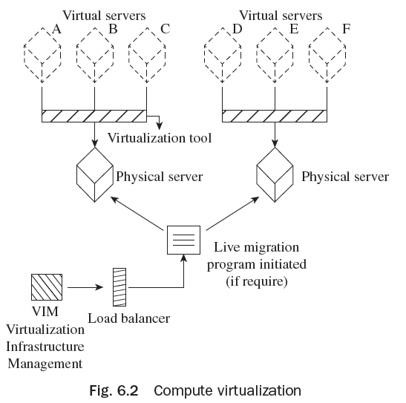
Server/Compute Virtualization

Slide 10
Server/Compute Components
The logical components of a server/compute system comprise the following:
File system
Operating system
Volume manager
Device drivers

Slide 11
Need of Server/Compute Virtualization
Compute virtualization facilitates and permits various applications and operating systems to function on a physical machine.
This method considerably minimizes charge and enhanced consumption. Resource management is the allotment of a physical machine or clustered physical machines to VMs.
Every physical machine and group has a parent resource pool which provides the resources of that physical machine or group.
Each child resource pool possesses a few of the resources of their parents. A parent resource pool may include virtual machines, child resource pools, or both.

Slide 12
Need of Server/Compute Virtualization
Present CPUs are prepared with hyper-threading characteristics and multiple cores per CPU. A multicore CPU is an incorporated circuit with which two or more processing units have been connected for improved functioning and more effective, synchronized processing of multiple resources.
A hypervisor augments and supports the CPU resources by use of modern CPU aspects such as hyper-threading and multicore. It also helps in the following ways:
1. Server consolidation
2. Improved security
3. Increased hardware consumption
4. Hardware independence and support portability
5. Decreased provisioning timing

Slide 13
Virtual Clusters
There are common agreements for most applications or users, such as user-level or OS programming libraries.
The VMs (guest systems) and physical machines (host systems) may operate with different OSes.
The virtual environment design should be able to function quickly. In this case, deployment should be to build and allocate software stacks (i.e., applications, OS, and libraries) to a physical node within clusters as quick as possible and to instantly switch run time environments from one virtual cluster of user to another.
Live moving VMs permit one to deliver workloads from one node to other one.
One more advantage for clustering carried by virtualization is load-balancing applications in a virtual cluster.

Slide 14
Advantages of Server/Compute Virtualization
Compute virtualization offers the following advantages:
Server consolidation
Segregation
Encapsulation
Non-dependence on hardware
Reduction in cost

Slide 15
Techniques of Server/Compute Virtualization
The three methods which manage confidential commands to virtualize the CPU are:
Full Virtualization
Para Virtualization
Hardware Assisted Virtualization

Slide 16
Virtual Machine and Hardware Components
A VM is a rational compute system similar to a physical machine which operates an application and an OS.
An operating system which works within a virtual machine is known as a guest operating system.
Network file system (NFS) and virtual machine file system (VMFS) are the file systems sustained by the hypervisor.
The VMFS is a group of file systems augmented to preserve files of a virtual machine.
In a virtualization environment, if any of the physical servers does not work properly, virtual infrastructure management (VIM) is initiated to divert traffic to a new selected physical server.

Slide 17
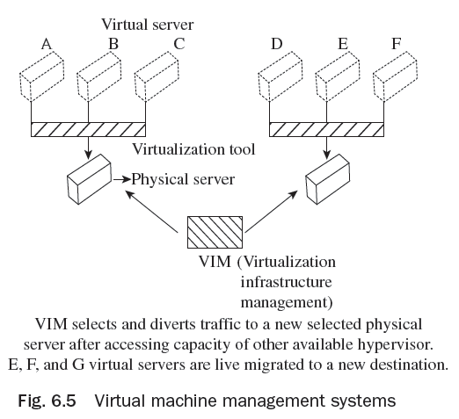
Virtual Machine and Hardware Components
In Fig. Virtual machine management systems, if E, F, and G virtual instances are not working, then live migration
of these E, F, and G into a new
destination will be carried out.

Slide 18
Hypervisor Taxonomy
A hypervisor, also known as a virtual machine manager, is a program that permits multiple operating systems to share one hardware host.
Hypervisor is compute virtualization software which facilitates manifold operating systems to operate on physical machines simultaneously.
The hypervisor is the main constituent of the data center consolidation.
Hypervisor has two main constituents—virtual machine monitor (VMM) and kernel.

Slide 19
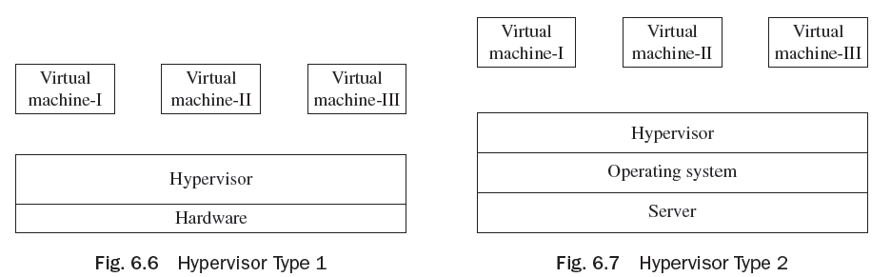
Hypervisor Taxonomy
Hypervisors are categorized into two types:
Type 1 (Bare-metal hypervisor)
Type 2 (Hosted hypervisor)

Slide 20
Resource Management and Tools
Cloud resource management needs versatile judgments and policies for multi-objective optimization.
The policies for cloud resource management associated with the three cloud delivery models, Software as a Service (SaaS), Platform as a Service (PaaS), and Infrastructure as a Service (IaaS) vary from each other.
In cloud computing, where alterations are common and spontaneous, centralized control is not believable to offer a persistent service and performance assurances.
Resource management policies frequently mutually target power utilization and performance.

Slide 21
Resource Management and Tools
Resource management is the allotment of a physical machine or clustered physical machines to virtual machines.
Unused memory allocated by a virtual machine to CPU can be accessed and used by other virtual machines without disturbing other resources.
Some virtual machines can enclose the same user data, administer the same guest operating system, or have the same applications.
A hypervisor recognizes surplus pages copied by their contents.
Virtual machines may securely alter the shared pages without disturbing other virtual machines which are sharing that memory.

Slide 22
Physical Machine to Virtual Machine (P2v) Conversion
A VM maintains a relationship between various virtual machines, and between a hypervisor and a VM in a grouped server environment.
Physical to VM exchange is a procedure via which a physical machine is transformed into a virtual machine. When transforming a physical machine, the ‘converter application’ (Converter) copies data on the hard disk of the source machine and shifts that data to the target virtual disk.
Advantages of P2V converters are:
1. Runs migration among heterogeneous hardware
2. Minimizes time required to set up a new virtual machine
3. Permits migration of machines to a new hardware without re-launching the
application or operating system

Slide 23
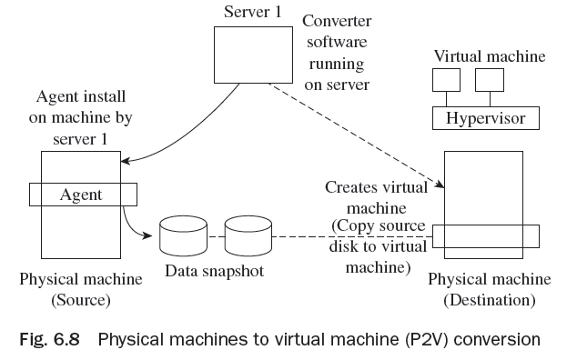
Physical Machine to Virtual Machine (P2v) Conversion
The P2V ‘converter application’ comprises three constituents—converter server, converter agent, and converter boot CD.
There are two means to shift from physical machine to virtual machine (VM). These are cold migration and hot
migration.

Slide 24
Types of Virtualization
Different types of virtualization are :
Data Center Virtualization
Server Virtualization
Storage Virtualization
Sensor Virtualization

Slide 25
Storage Area Network
Storage area network (SAN) refers to the LAN design for managing huge amounts of data transfer.
It uses interconnection technology for supporting data storage, retrieval, and replication. NAS works on TCP/IP, whereas SAN for disk blocks transformation works on low-level network protocols.
Storage area networks are actually designed for data management. It is a rapid storage device network and can be connected with servers.
SAN is helpful for transferring data from one storage device to another without disturbing other devices.
SAN also supports fast backup as CPU cycles of server are not involved in the backup process. At the time of recovery, SAN plays an important role.

Slide 26
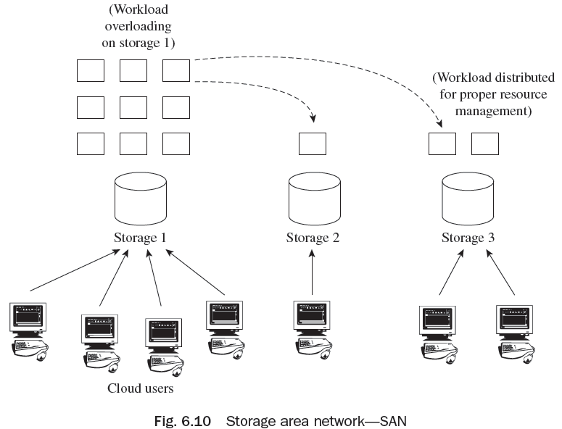
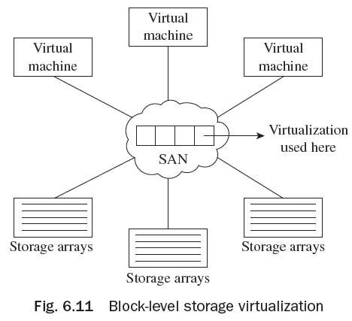
Storage Area Network

Slide 27
Network Attached Storage
Network-attached storage (NAS) is actually a dedicated file storage device for providing local area network nodes with file-based shared storage using a standard ethernet connection.
NAS has its own IP address and each NAS exists on the LAN as an independent network node.
Some examples of NAS devices include Seagate Central, Seagate Business Storage NAS, and 8-Bay Rackmounts. All NAS products provide a secure and centralized location for the files.
Accessing of NAS system storage data is easy—it can be accessed from anywhere, whether one is in own house, on another computer, or through mobile, Wi-fi technology, etc.

Slide 28
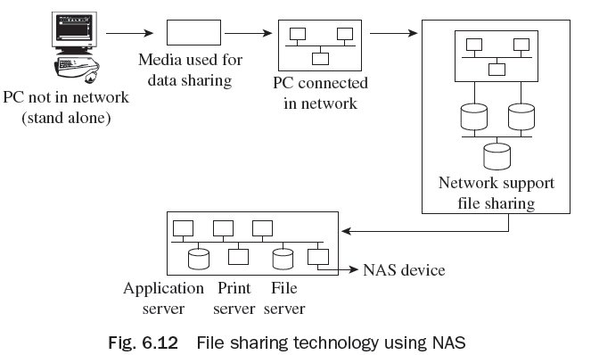
Network Attached Storage
NAS has the following benefits:
Broad access to information
Better efficiency
Better flexibility
Centralized storage
Simplified management
Scalability
High availability
Security

Slide 29
Network Attached Storage
NAS has the following components:
NAS head (CPU and memory)
Network interface cards (NICs) for providing connectivity
Operating system for handling NAS functionality
Network file system (NFS) and common Internet file system (CIFS) protocols for file sharing. NFS mainly supports UNIX-based operating environments, whereas CIFS is supported by Microsoft Windows-based operating environments. Supported file sharing protocols facilitate users to share files with different operating platforms.
Storage protocols to connect and manage physical disk resources
Storage array

Slide 30
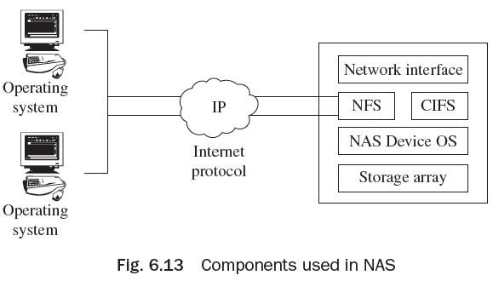
Network Attached Storage
Comparison between SAN and NAS:
Storage area network (SAN) supports networking, whereas network-attached storage (NAS) is a storage device, in a network.
Operating systems consider SAN as a disk, whereas a NAS device is a file server.
SAN supports block-level storage for servers, whereas NAS devices support file-level storage. For saving files such as word documents or MS Excel spreadsheets, NAS is generally used.

Slide 31
Thank You!

